Slide 1
A new image classification method based on ResNet
ZhengFeng

Slide 2
Introduction
Time limit: 10 minutes
Dataset: CIFAR10
Data augmentation
Random crop
Horizontal flip
Normalization

Slide 3
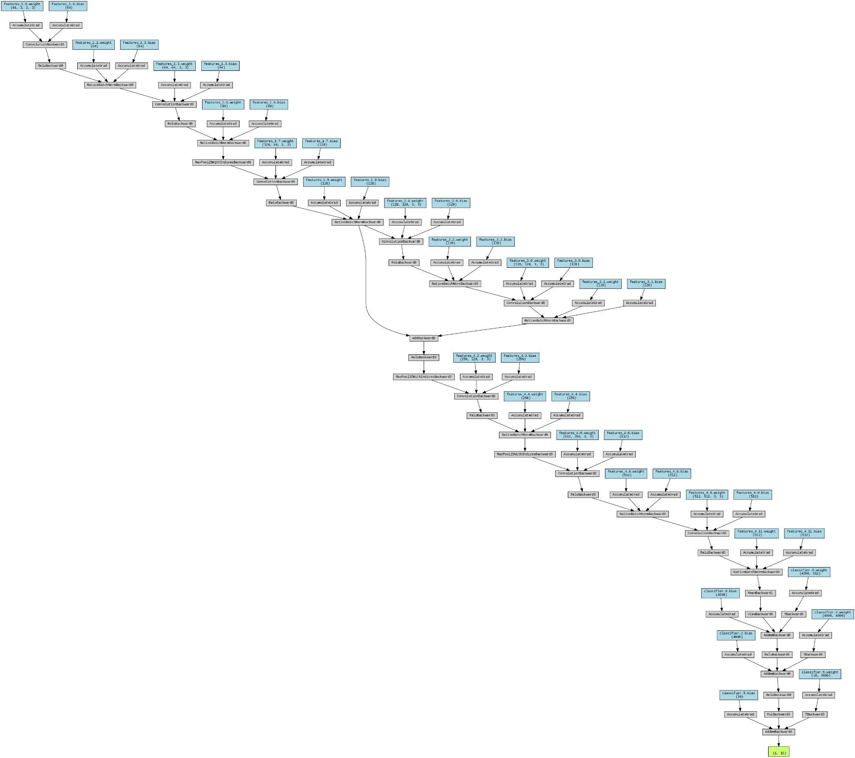
Network Overview
Modified based on assignment 2 network structure
Inspired by Resnet architecture
Residual module + VGG architecture

Slide 4
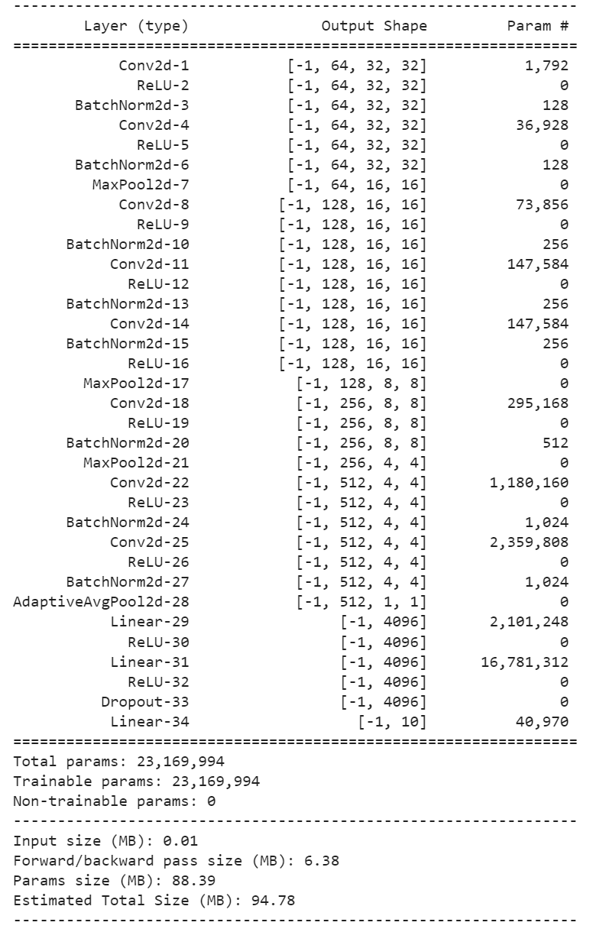
Visualisation
Network design methodology
Training epochs: 12
Batchsize: 512

Slide 5
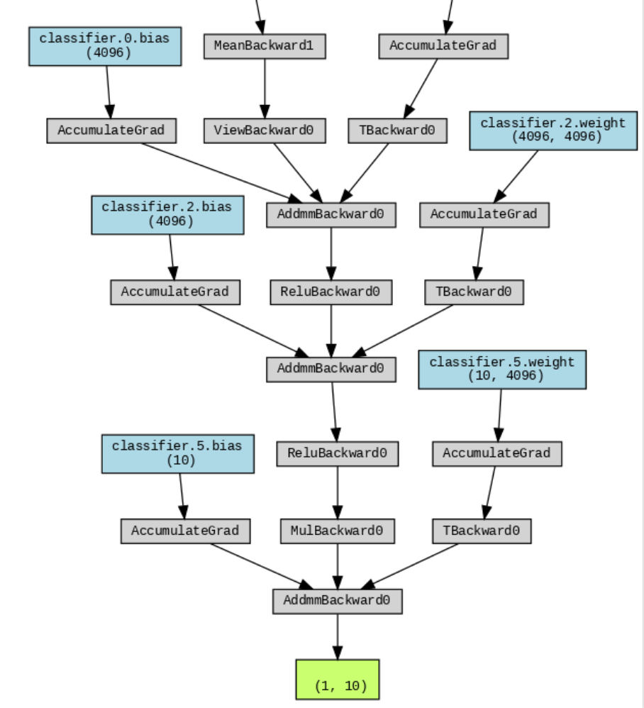
Classifier
Fully connected layer 4096 neurons
Dropout rate: 0.4

Slide 6
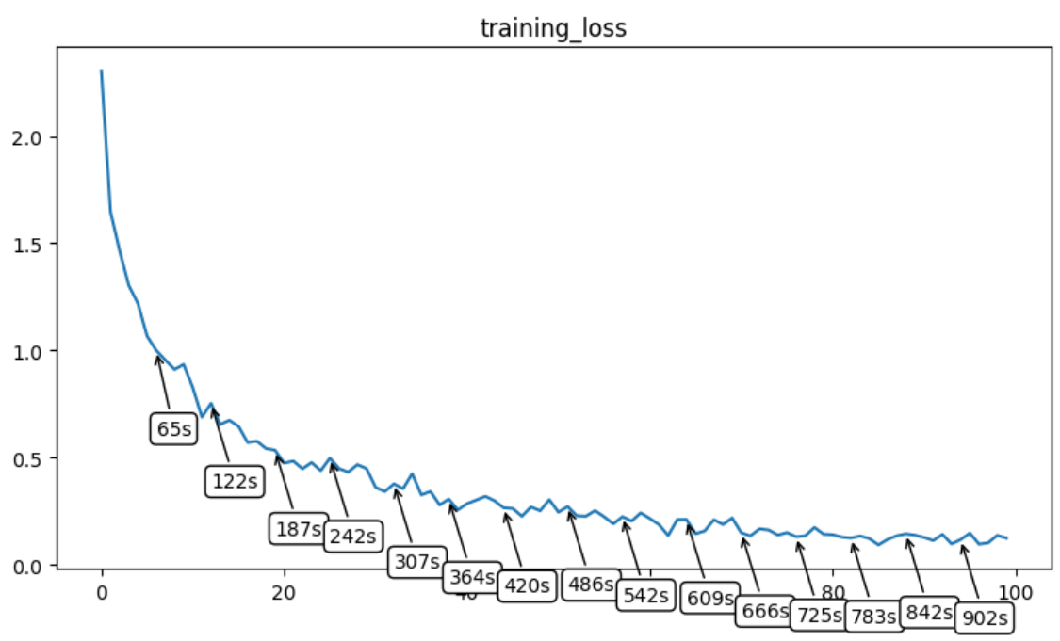
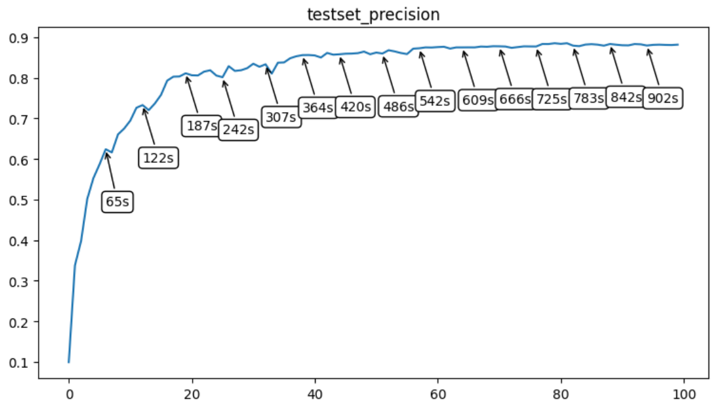
Result
New method: best precision: 0.8852

Slide 7
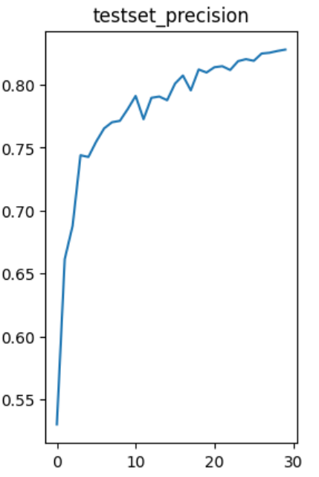
Improvement
0.8456 VS 0.8852

Slide 8
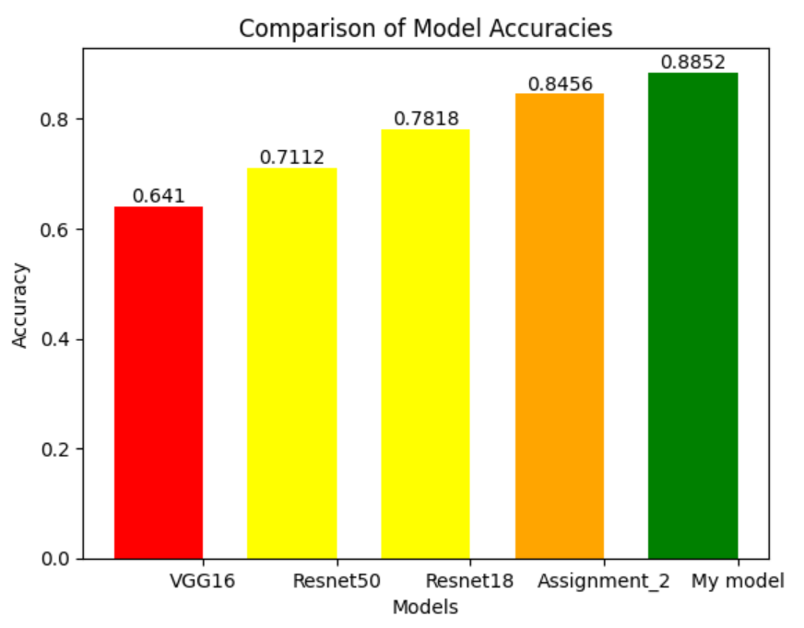
Comparison
My model: 0.8852
Assignment2: 0.8456
Resnet18: 0.7818
Resnet50: 0.7112
VGG16: 0.641

Slide 9
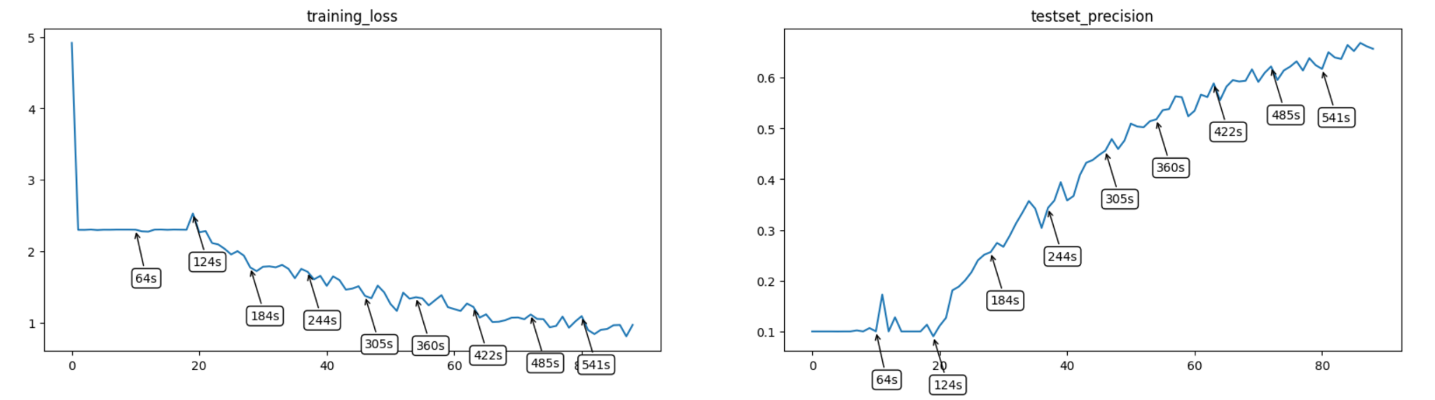
VGG16

Slide 10
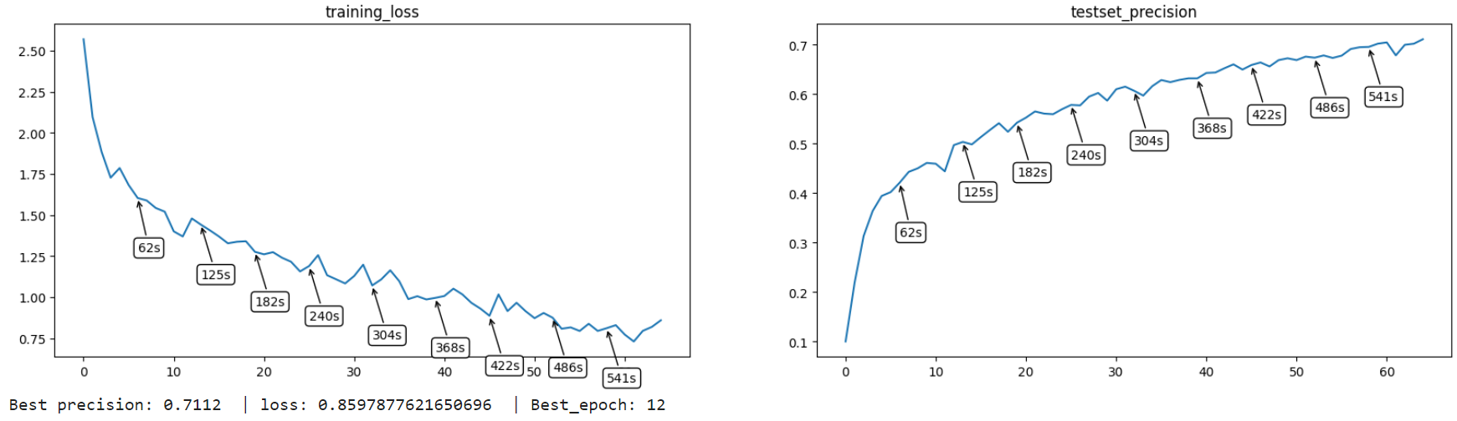
ResNet50

Slide 11
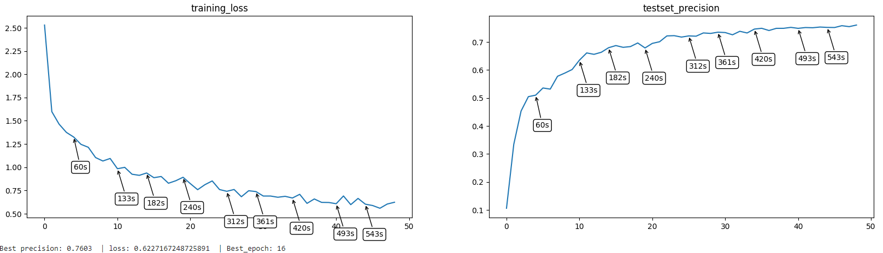
ResNet18

Slide 12
Conclusion & Future work
Complex network are not necessarily efficient (time limit)
Accuracy does not reach 90%, we have more work to do
Use more model and modify

Slide 13
Thank you!

